Slide 1
Project Title: Hotel Reservation and Room Management
Presented by: Fatima Tuz Samiha
ID: 2312003642
Course:Cse311
Section: 8
Faculty:MKN1

Slide 2
Project Overview: Hotel Reservation and Room Management System
The Hotel Reservation and Room Management System is a web-based application designed to simplify the process of managing hotel operations, including guest registration, room availability, and reservations. The system provides a centralized platform for hotel staff to efficiently handle day-to-day activities and for guests to easily book rooms.

Slide 3
Key Features:
Guest Registration: Allows staff to record guest details such as name, phone number, and email. Each guest is assigned a unique ID for future reference.
Room Management: Displays all rooms in the hotel along with their type, price per night, and current status (available or booked). Staff can update room status automatically when a room is reserved.
Reservation System: Enables booking of rooms by guests. Staff can select a guest, choose a room, enter check-in and check-out dates, and specify the number of guests.
Automated Status Update: When a room is booked, its status changes to “booked,” preventing double bookings.
Reporting & Monitoring: Provides an organized table view of rooms and reservations, allowing easy monitoring of room occupancy and guest details.

Slide 4
Objectives:
Streamline the reservation process for both staff and guests.
Minimize booking errors and double bookings.
Maintain organized records of guests and room availability.
Improve overall efficiency in hotel management operations.
Technologies Used:
Backend: PHP, MySQL
Frontend: HTML, CSS

Slide 5
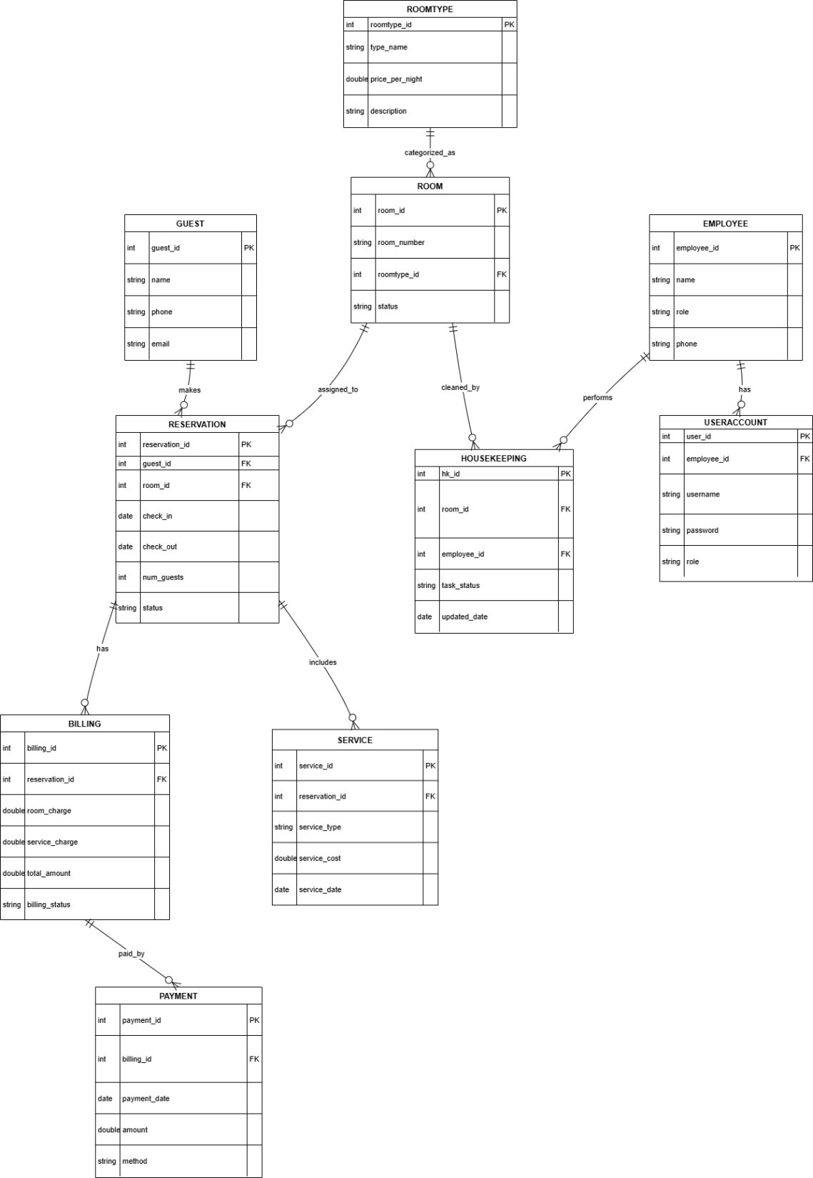
ER DIAGRAM:

Slide 6
Relational schema
1. ROOMTYPE (roomtype_id, type_name, price_per_night, description)
  PK: roomtype_id
2. ROOM (room_id, room_number, roomtype_id, status)
  PK: room_id
  FK: roomtype_id → ROOMTYPE(roomtype_id)
3. GUEST (guest_id, name, phone, email)
  PK: guest_id
4. RESERVATION (reservation_id, guest_id, room_id, check_in, check_out, num_guests, status)
  PK: reservation_id
  FK1: guest_id → GUEST(guest_id)
  FK2: room_id → ROOM(room_id)
5. BILLING (billing_id, reservation_id, room_charge, service_charge, total_amount, billing_status)
  PK: billing_id
  FK: reservation_id → RESERVATION(reservation_id)
  PK: payment_id
6. PAYMENT (payment_id, billing_id, payment_date, amount, method)
  FK: billing_id → BILLING(billing_id)
7. SERVICE (service_id, reservation_id, service_type, service_cost, service_date)
  PK: service_id
  FK: reservation_id → RESERVATION(reservation_id)
8. EMPLOYEE (employee_id, name, role, phone)
  PK: employee_id
9. HOUSEKEEPING (hk_id, room_id, employee_id, task_status, updated_date)
  PK: hk_id
  FK1: room_id → ROOM(room_id)
  FK2: employee_id → EMPLOYEE(employee_id)
10. USERACCOUNT (user_id, employee_id, username, password, role)
  PK: user_id
  FK: employee_id → EMPLOYEE(employee_id)

Slide 7
Normalization
1. ROOMTYPE
  1NF: All attributes are atomic
  2NF: PK = roomtype_id (single attribute) .So No partial dependency.
  3NF: No non-key attribute depends on another non-key attribute.
  (type_name does not determine price_per_night, etc.)
  BCNF: All determinants are keys.
2. ROOM(room_id, room_number, roomtype_id, status)
  1NF: All atomic
  2NF: PK = room_id (single attribute) → No partial dependency.
  3NF: No transitive dependency between non-key attributes.
  BCNF: room_id is the only determinant . So ROOM is in BCNF.
3. GUEST(guest_id, name, phone, email)
  Atomic attributes and single-column PK.
  So From 1NF to BCNF satisfied
4. RESERVATION(reservation_id, guest_id, room_id, check_in, check_out, num_guests, status)
  1NF: All atomic.
  2NF: PK = reservation_id → No partial dependency.
  3NF: No attribute depends on another non-key attribute.
  Example: check_in does not determine check_out.
  BCNF: Every determinant is a candidate key.
  So RESERVATION is in BCNF.
5. BILLING(billing_id, reservation_id, room_charge, service_charge, total_amount, billing_status)
  1NF:Atomic.
  2NF:PK = billing_id → No partial dependency.
  3NF: No non-key attribute determines another.
  total_amount = room_charge + service_charge (derived but not violating 3NF)
  BCNF: billing_id is the only determinant.
  So BILLING is in BCNF.

Slide 8
6. PAYMENT
  (payment_id, billing_id, payment_date, amount, method)
  one PK, no transitive dependencies.
7. SERVICE
  (service_id, reservation_id, service_type, service_cost, service_date)
  Fully atomic, single-column PK.
8. EMPLOYEE
  (employee_id, name, role, phone)
  All attributes are atomic.
  No functional dependencies except employee_id
9. HOUSEKEEPING
  (hk_id, room_id, employee_id, task_status, updated_date)
  Single-column PK, no nested dependencies.
10. USERACCOUNT
  (user_id, employee_id, username, password, role)
  1NF:Atomic.
  2NF: PK = user_id → No partial dependency.
  3NF:Employee_id → employee role is already stored in EMPLOYEE,
  But here "role" means system role (admin, staff) → no conflict.
  BCNF: user_id is only determinant.

Slide 9
SQL query
GUEST
  CREATE TABLE guest (
  guest_id INT AUTO_INCREMENT PRIMARY KEY,
  name VARCHAR(100) NOT NULL,
  phone VARCHAR(20),
  email VARCHAR(100)
  );
ROOMTYPE
  CREATE TABLE roomtype (
  roomtype_id INT AUTO_INCREMENT PRIMARY KEY,
  type_name VARCHAR(50) NOT NULL,
  price_per_night DOUBLE NOT NULL,
  description VARCHAR(255)
  );
ROOM
  CREATE TABLE room (
  room_id INT AUTO_INCREMENT PRIMARY KEY,
  room_number VARCHAR(10) NOT NULL,
  roomtype_id INT NOT NULL,
  status ENUM('available','booked') DEFAULT 'available',
  FOREIGN KEY (roomtype_id) REFERENCES roomtype(roomtype_id)
  );
RESERVATION
  CREATE TABLE reservation (
  reservation_id INT AUTO_INCREMENT PRIMARY KEY,
  guest_id INT NOT NULL,
  room_id INT NOT NULL,
  check_in DATE NOT NULL,
  check_out DATE NOT NULL,
  num_guests INT NOT NULL,
  status ENUM('confirmed','cancelled') DEFAULT 'confirmed',
  FOREIGN KEY (guest_id) REFERENCES guest(guest_id),
  FOREIGN KEY (room_id) REFERENCES room(room_id)
  );
BILLING
  CREATE TABLE billing (
  billing_id INT AUTO_INCREMENT PRIMARY KEY,
  reservation_id INT NOT NULL,
  room_charge DOUBLE NOT NULL,
  service_charge DOUBLE DEFAULT 0,
  total_amount DOUBLE NOT NULL,
  billing_status ENUM('paid','unpaid') DEFAULT 'unpaid',
  FOREIGN KEY (reservation_id) REFERENCES reservation(reservation_id)
  );

Slide 10
PAYMENT
  CREATE TABLE payment (
  payment_id INT AUTO_INCREMENT PRIMARY KEY,
  billing_id INT NOT NULL,
  payment_date DATE NOT NULL,
  amount DOUBLE NOT NULL,
  method ENUM('cash','card','online'),
  FOREIGN KEY (billing_id) REFERENCES billing(billing_id)
  );
EMPLOYEE
  CREATE TABLE employee (
  employee_id INT AUTO_INCREMENT PRIMARY KEY,
  name VARCHAR(100) NOT NULL,
  role VARCHAR(50),
  phone VARCHAR(20)
  );
USERACCOUNT
  CREATE TABLE useraccount (
  user_id INT AUTO_INCREMENT PRIMARY KEY,
  employee_id INT NOT NULL,
  username VARCHAR(50) NOT NULL UNIQUE,
  password VARCHAR(255) NOT NULL,
  role VARCHAR(50),
  FOREIGN KEY (employee_id) REFERENCES employee(employee_id)
  );
SERVICE
  CREATE TABLE service (
  service_id INT AUTO_INCREMENT PRIMARY KEY,
  reservation_id INT NOT NULL,
  service_type VARCHAR(50),
  service_cost DOUBLE,
  service_date DATE,
  FOREIGN KEY (reservation_id) REFERENCES reservation(reservation_id)
  );
HOUSEKEEPING
  CREATE TABLE housekeeping (
  hk_id INT AUTO_INCREMENT PRIMARY KEY,
  room_id INT NOT NULL,
  employee_id INT NOT NULL,
  task_status ENUM('pending','completed') DEFAULT 'pending',
  updated_date DATE,
  FOREIGN KEY (room_id) REFERENCES room(room_id),
  FOREIGN KEY (employee_id) REFERENCES employee(employee_id)
  );

Slide 11
Frontend (HTML and CSS)
  HTML:
  <!DOCTYPE html>
  <html lang="en">
  <head>
  <meta charset="UTF-8">
  <meta name="viewport" content="width=device-width, initial-scale=1.0">
  <title>Hotel Management System</title>
  <link rel="stylesheet" href="style.css">
  </head>
  <body>
  <header>
  <h1>Hotel Reservation & Room Management</h1>
  <nav>
  <a href="index.html">Home</a>
  <a href="rooms.php">Rooms</a>
  <a href="guest_register.php">Guest Register</a>
  <a href="login.php">Login</a>
  </nav>
  </header>
  <main>
  <section class="hero">
  <h2>Welcome to Our Hotel</h2>
  <p>Book rooms, manage reservations, and handle billing easily.</p>
  <a href="rooms.php" class="btn">View Rooms</a>
  </section>
  </main>
  <footer>
  <p>&copy; 2025 Hotel Management System</p>
  </footer>
  </body>
  </html>

Slide 12
CSS:
body {
font-family: Arial, sans-serif;
margin: 0;
padding: 0;
background-color: #f0f0f0;
}
header {
background-color: #34495e;
color: white;
padding: 20px;
text-align: center;
}
nav a {
color: white;
margin: 0 15px;
text-decoration: none;
font-weight: bold;
}
nav a:hover {
text-decoration: underline;
}
.hero {
text-align: center;
margin: 50px;
}
.btn {
background-color: #e67e22;
color: white;
padding: 10px 20px;
text-decoration: none;
border-radius: 5px;
}
.btn:hover {
background-color: #d35400;
}
footer {
text-align: center;
padding: 20px;
background-color: #34495e;
color: white;
}

Slide 13
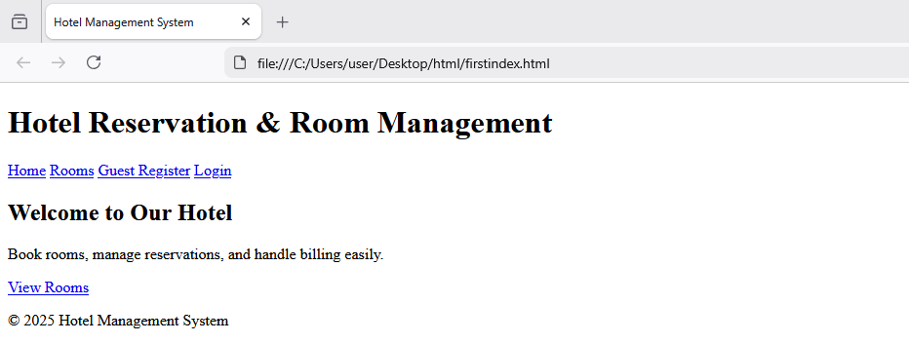

Slide 14
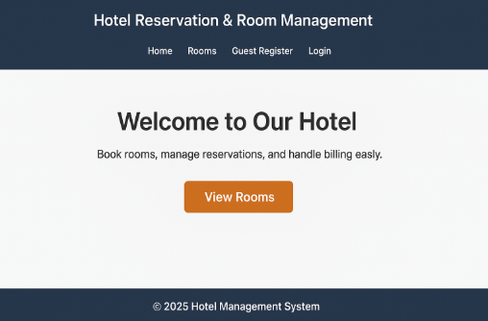

Slide 15
Backend (PHP + SQL):
<?php
$host = "localhost";
$user = "root";
$pass = "";
$db = "hotel_management";
$conn = new mysqli($host, $user, $pass, $db);
if ($conn->connect_error) {
die("Connection failed: " . $conn->connect_error);
}
?>
<?php
include 'db.php';
if ($_SERVER['REQUEST_METHOD'] == 'POST') {
$name = $_POST['name'];
$phone = $_POST['phone'];
$email = $_POST['email'];
$sql = "INSERT INTO guest (name, phone, email) VALUES ('$name', '$phone', '$email')";
if ($conn->query($sql) === TRUE) {
echo "Guest registered successfully!";
} else {
echo "Error: " . $conn->error;
}
}
?>
<h2>Guest Registration</h2>
<form method="POST">
<input type="text" name="name" placeholder="Name" required><br>
<input type="text" name="phone" placeholder="Phone"><br>
<input type="email" name="email" placeholder="Email" required><br>
<button type="submit">Register</button>
</form>
<?php
include 'db.php';
$result = $conn->query("SELECT room.room_id, room.room_number, room.status, roomtype.type_name, roomtype.price_per_night
FROM room
JOIN roomtype ON room.roomtype_id = roomtype.roomtype_id");
?>

Slide 16
<h2>Rooms</h2>
<table border="1">
<tr>
<th>Room Number</th>
<th>Type</th>
<th>Price/Night</th>
<th>Status</th>
<th>Action</th>
</tr>
<?php while($row = $result->fetch_assoc()) { ?>
<tr>
<td><?= $row['room_number'] ?></td>
<td><?= $row['type_name'] ?></td>
<td><?= $row['price_per_night'] ?></td>
<td><?= $row['status'] ?></td>
<td>
<?php if($row['status'] == 'available') { ?>
<a href="reservation.php?room_id=<?= $row['room_id'] ?>">Book</a>
<?php } else { echo "Booked"; } ?>
</td>
</tr>
<?php } ?>
</table>
<?php
include 'db.php';
$room_id = $_GET['room_id'];
if ($_SERVER['REQUEST_METHOD'] == 'POST') {
$guest_id = $_POST['guest_id'];
$check_in = $_POST['check_in'];
$check_out = $_POST['check_out'];
$num_guests = $_POST['num_guests'];
$sql = "INSERT INTO reservation (guest_id, room_id, check_in, check_out, num_guests)
VALUES ($guest_id, $room_id, '$check_in', '$check_out', $num_guests)";
$conn->query("UPDATE room SET status='booked' WHERE room_id=$room_id");
if ($conn->query($sql)) {
echo "Reservation successful!";
} else {
echo "Error: " . $conn->error;
}
}
?>
<h2>Book Room</h2>
<form method="POST">
<label>Guest ID:</label>
<input type="number" name="guest_id" required><br>
<label>Check-in Date:</label>
<input type="date" name="check_in" required><br>
<label>Check-out Date:</label>

Slide 17
<label>Check-out Date:</label>
<input type="date" name="check_out" required><br>
<label>Number of Guests:</label>
<input type="number" name="num_guests" required><br>
<button type="submit">Book Room</button>
</form>

Slide 18
